Slide 1
Development
in
data science
And
Machine learning

Slide 2
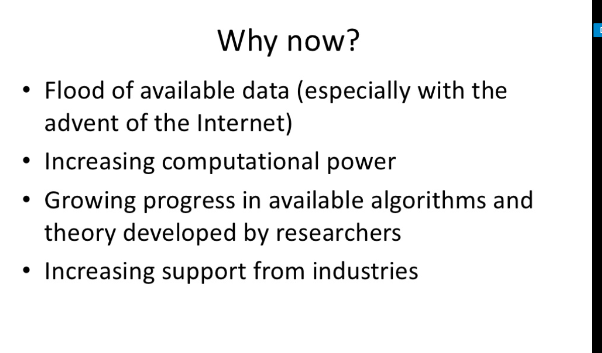

Slide 3
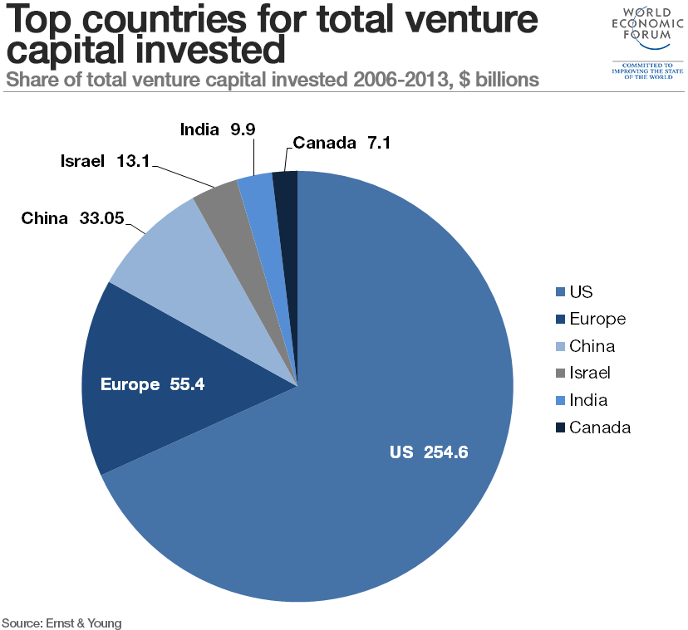
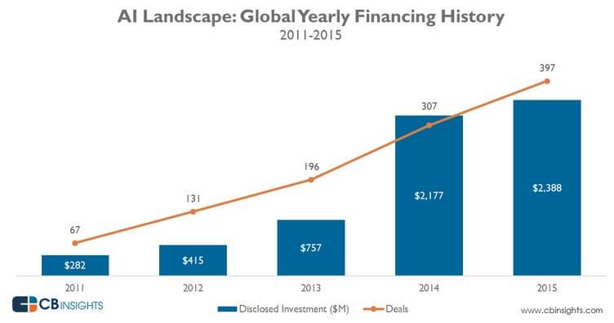
Global investments in ai

Slide 4
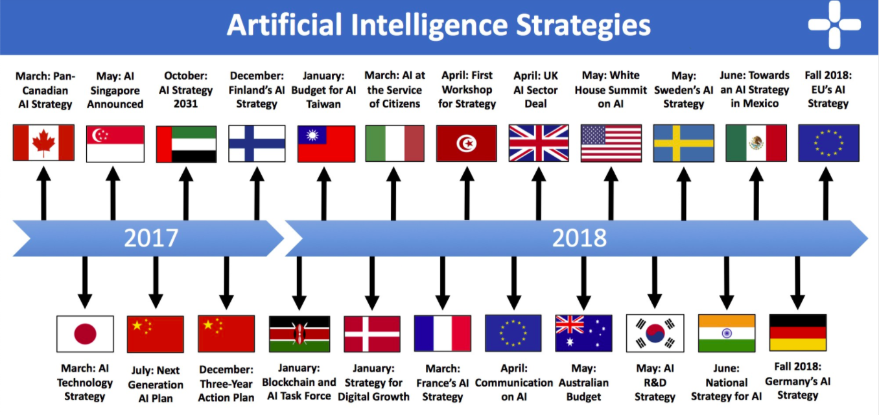
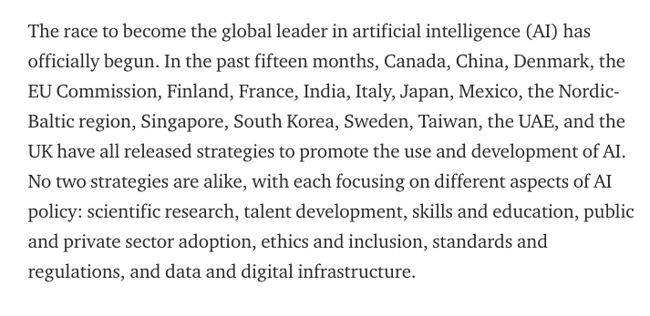
Global strategies for ai

Slide 5
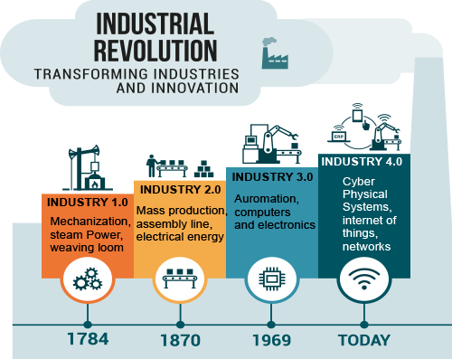
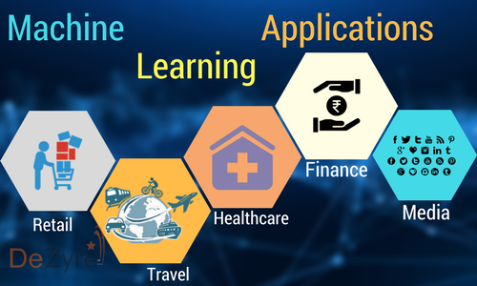
Industries and ai

Slide 6
Getting started with artificial intelligence
&
Data science

Slide 7
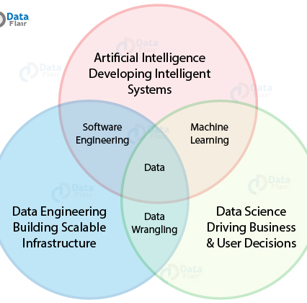
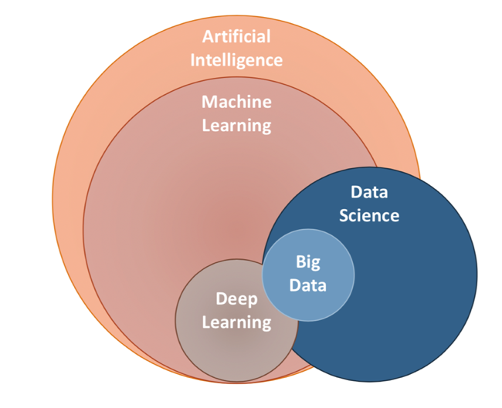
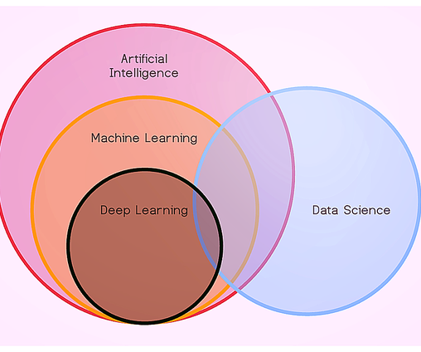
Ai and data science

Slide 8
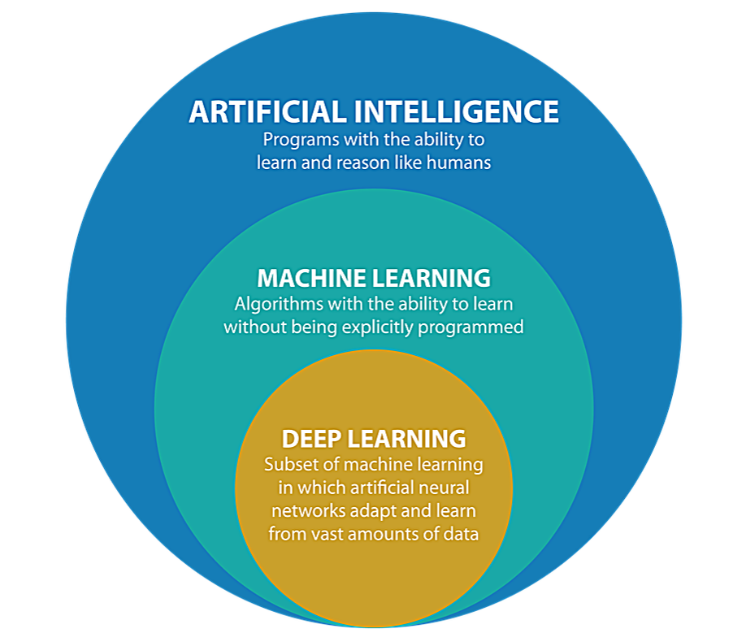
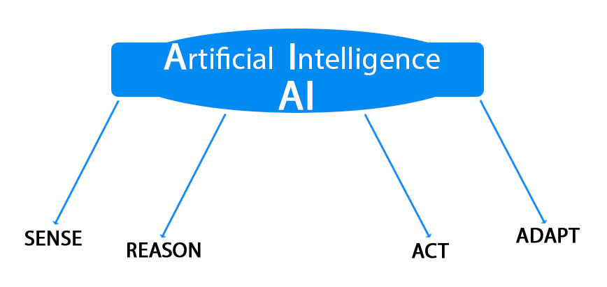
Ai and subdivisions

Slide 9
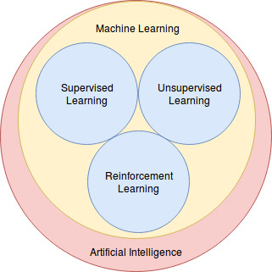
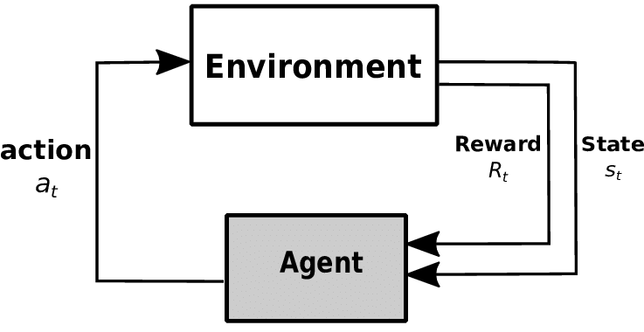
Ml and rl

Slide 10
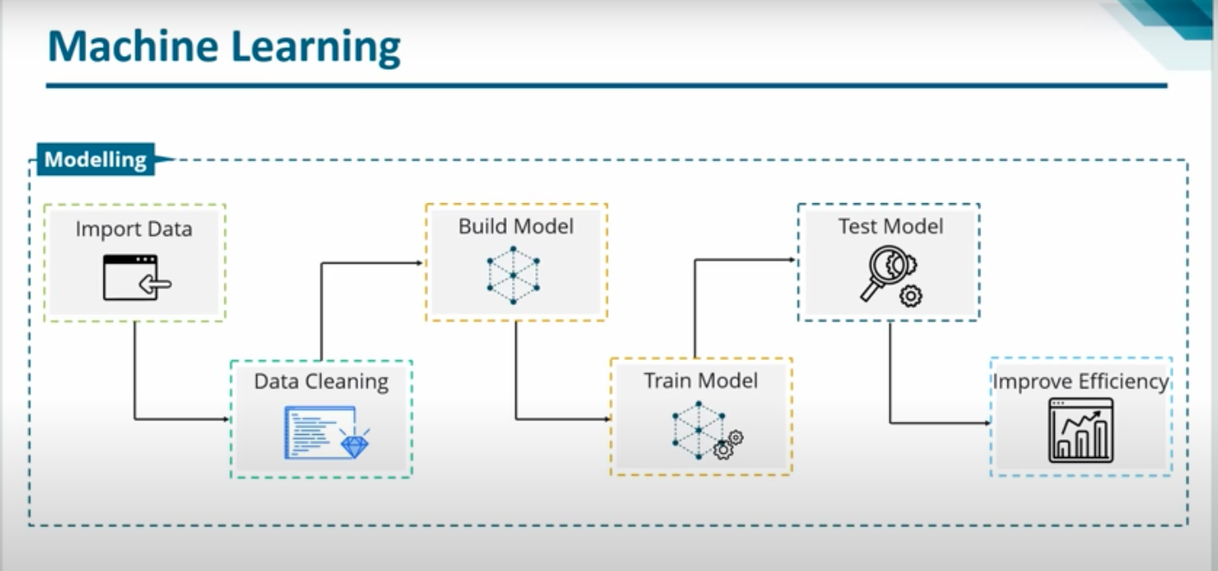
Basic structure of ml model

Slide 11
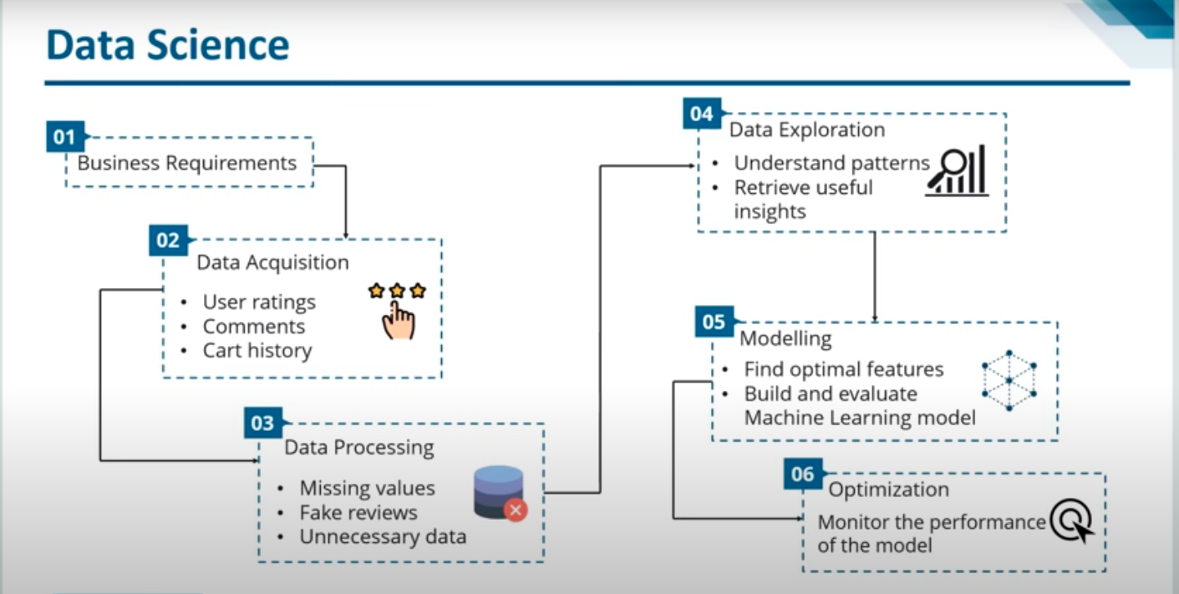
Basic structure of data science

Slide 12
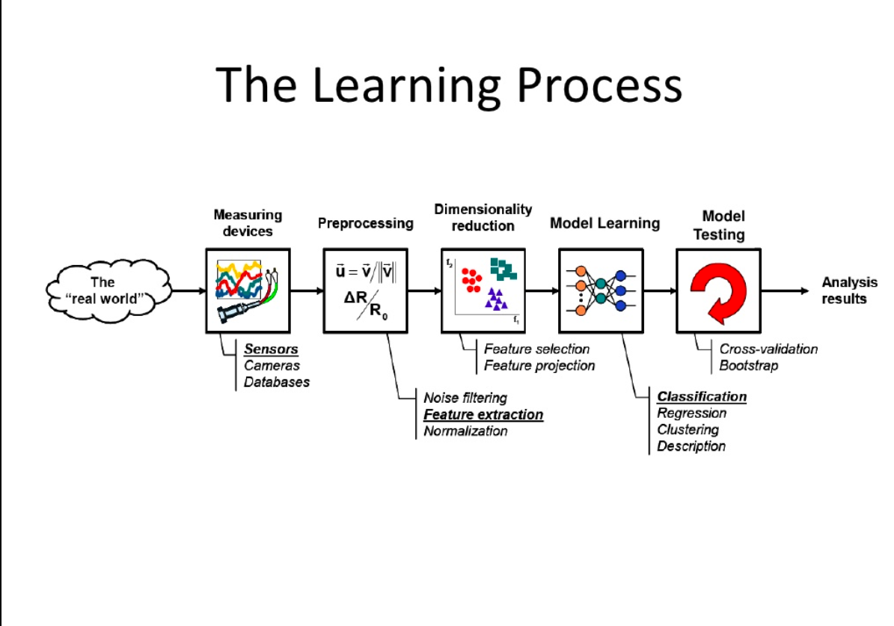

Slide 13
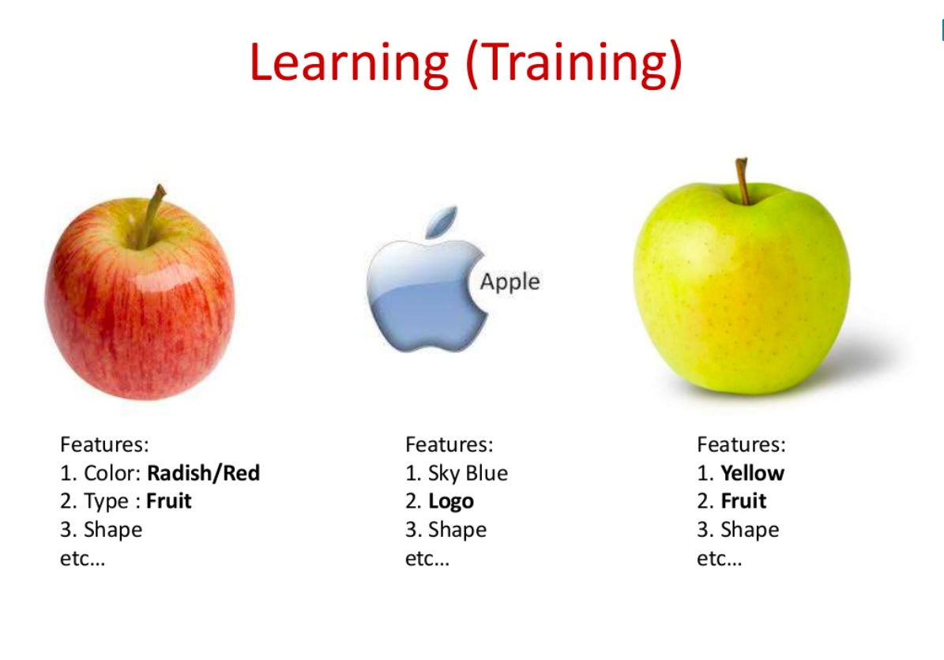

Slide 14
Approach for learning
(Ml)

Slide 15
Approach to follow in machine learning
BASIC PYTHON
DATA STRUCTURES
FUNCTIONS (complex problems)
OOPS
LIBRARIES ( numpy , pandas )
STATISTICS (libraries)
FEATURE ENGINEERING AND RELATIONS
EDA (exploitary data analysis)
MACHINE LEARNING ALGORITHMS (COCKTAIL PARTY)
RL LIBRARIES ( pytorch , tenserflow )
Virtual SIMULATOR ( YOUTUBE TUTORIAL)

Slide 16
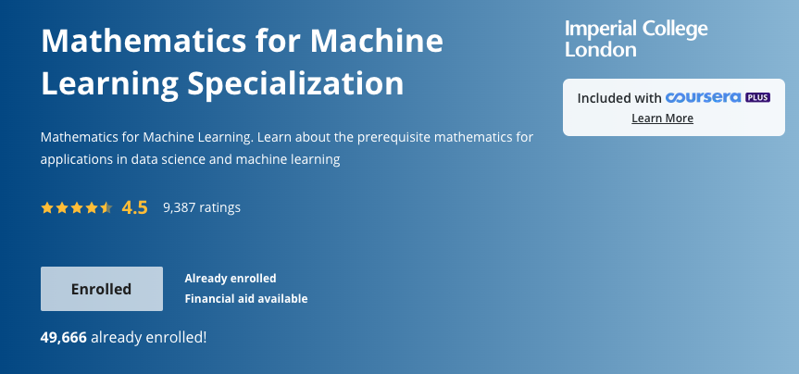
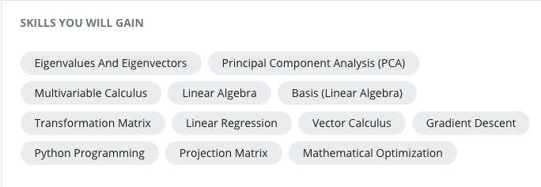

Slide 17
COURSE FOR BASIC PYTHON
(YOUTUBE , COURSERA)

Slide 18
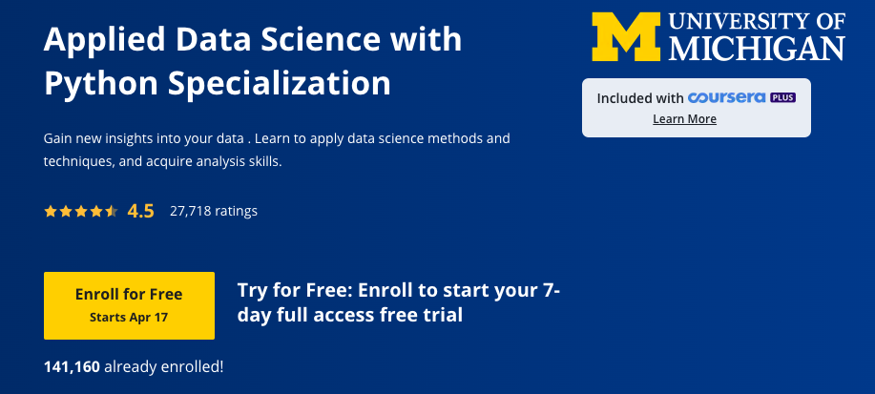
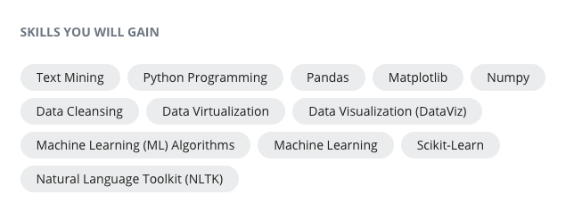

Slide 19


